Slide 1
id alert_datetime alert_type alert_zone locality \
0 1 2018-12-26 08:05:08 Red Alert Dan Tel Aviv (South West)
1 2 2018-12-26 08:05:08 Red Alert Dan Tel Aviv (North)
2 3 2018-12-26 08:05:08 Red Alert Dan Tel Aviv (Central)
3 4 2018-12-26 08:05:08 Red Alert Dan Tel Aviv (South East)
4 5 2018-12-26 08:05:08 Red Alert Dan Azur
region raw_message_id city
0 Tel Aviv 42 Tel Aviv-Yafo
1 Tel Aviv 42 Tel Aviv-Yafo
2 Tel Aviv 42 Tel Aviv-Yafo
3 Tel Aviv 42 Tel Aviv-Yafo
4 Tel Aviv 42 Azur

Slide 2
Index(['id', 'alert_datetime', 'alert_type', 'alert_zone', 'locality',
'region', 'raw_message_id', 'city'],
dtype='object')

Slide 3
np.int64(0)

Slide 4
np.False_

Slide 5
<class 'pandas.core.frame.DataFrame'>
Index: 100304 entries, 0 to 100324
Data columns (total 8 columns):
# Column Non-Null Count Dtype
--- ------ -------------- -----
0 id 100304 non-null int64
1 alert_datetime 100304 non-null datetime64[ns]
2 alert_type 100304 non-null object
3 alert_zone 100304 non-null object
4 locality 100304 non-null object
5 region 100304 non-null object
6 raw_message_id 100304 non-null int64
7 city 100304 non-null object
dtypes: datetime64[ns](1), int64(2), object(5)
memory usage: 6.9+ MB

Slide 6
id alert_datetime raw_message_id
count 100,304.00 100304 100,304.00
mean 50,164.69 2024-08-16 21:00:04.060874752 30,928.46
min 1.00 2018-12-26 08:05:08 42.00
25% 25,077.75 2024-05-17 15:01:15.500000 21,228.00
50% 50,168.50 2024-11-24 15:34:49 38,162.00
75% 75,246.25 2025-06-16 04:11:16 41,226.00
max 100,325.00 2026-01-02 10:02:40 44,171.00
std 28,961.96 NaN 12,822.91

Slide 7
alert_region count
0 North 34227
1 Center 30554
2 South 18834
3 Yosh 6076
4 Jerusalem 3940
5 Haifa 3387
6 Tel Aviv 3286

Slide 8
alert_zone count
0 Confrontation Line 14966
1 Lakhish 9725
2 HaShfela 8914
3 Sharon 7434
4 Upper Galilee 6865
.. ... ...
60 מיני ישראל 1
61 יהוד מונוסון 1
62 שוהם 1
63 Nili 1
64 Milouot Industrial North 1
[65 rows x 2 columns]

Slide 9
alert_zone count
0 Confrontation Line 14966
1 Lakhish 9725
2 HaShfela 8914
3 Sharon 7434
4 Upper Galilee 6865
.. ... ...
60 מיני ישראל 1
61 יהוד מונוסון 1
62 שוהם 1
63 Nili 1
64 Milouot Industrial North 1
[65 rows x 2 columns]

Slide 10
region
North 14276
South 475
Center 215
Name: count, dtype: int64

Slide 11
alert_zone lon lat
0 Arabah 35.00 30.50
1 Arava 35.00 30.80
2 Ashdod 34.64 31.80
3 Beit She'an Valley 35.50 32.50
4 Beit Shemesh 34.99 31.73

Slide 12
alert_zone count lon lat
0 Confrontation Line 14966 35.00 31.50
1 Lakhish 9725 34.80 31.50
2 HaShfela 8914 34.80 31.80
3 Sharon 7434 34.87 32.18
4 Upper Galilee 6865 35.30 33.00
.. ... ... ... ...
60 מיני ישראל 1 32.10 34.95
61 יהוד מונוסון 1 32.20 34.90
62 שוהם 1 31.90 35.00
63 Nili 1 31.75 35.00
64 Milouot Industrial North 1 31.50 34.90
[65 rows x 4 columns]

Slide 13
alert_city count
0 Ashdod 2585
1 Ashkelon 1041
2 Nir Am 731
3 Tel Aviv-Yafo 622
4 Kiryat Shmona 595
... ... ...
1495 Neveh Haim 1
1496 Yearot HaCarmel 1
1497 North 1
1498 South 1
1499 Azuz 1
[1500 rows x 2 columns]

Slide 14
id alert_datetime alert_type alert_zone \
0 1 2018-12-26 08:05:08 Red Alert Dan
1 2 2018-12-26 08:05:08 Red Alert Dan
2 3 2018-12-26 08:05:08 Red Alert Dan
3 4 2018-12-26 08:05:08 Red Alert Dan
4 5 2018-12-26 08:05:08 Red Alert Dan
.. ... ... ... ...
195 196 2019-03-15 04:08:40 Red Alert Gaza Containment
196 197 2019-03-15 04:08:40 Red Alert Gaza Containment
197 198 2019-03-15 04:08:40 Red Alert Gaza Containment
198 199 2019-03-15 04:08:40 Red Alert Gaza Containment
199 200 2019-03-15 04:08:40 Red Alert Gaza Containment
locality region raw_message_id \
0 Tel Aviv (South West) Tel Aviv 42
1 Tel Aviv (North) Tel Aviv 42
2 Tel Aviv (Central) Tel Aviv 42
3 Tel Aviv (South East) Tel Aviv 42
4 Azur Tel Aviv 42
.. ... ... ...
195 Sapir Academy South 80
196 Nir Am South 80
197 Sapirim Industrial Park South 80
198 Sderot South 80
199 Sha'ar Hanegev Industries South 80
city alert_date alert_time
0 Tel Aviv-Yafo 2018-12-26 1900-01-01 08:05:08
1 Tel Aviv-Yafo 2018-12-26 1900-01-01 08:05:08
2 Tel Aviv-Yafo 2018-12-26 1900-01-01 08:05:08
3 Tel Aviv-Yafo 2018-12-26 1900-01-01 08:05:08
4 Azur 2018-12-26 1900-01-01 08:05:08
.. ... ... ...
195 Sapir 2019-03-15 1900-01-01 04:08:40
196 Nir Am 2019-03-15 1900-01-01 04:08:40
197 Sapirim Industrial Park 2019-03-15 1900-01-01 04:08:40
198 Sderot 2019-03-15 1900-01-01 04:08:40
199 Shaar Hanegev Industries 2019-03-15 1900-01-01 04:08:40
[200 rows x 10 columns]

Slide 15
id alert_datetime alert_type alert_zone locality \
0 1 2018-12-26 08:05:08 Red Alert Dan Tel Aviv (South West)
1 2 2018-12-26 08:05:08 Red Alert Dan Tel Aviv (North)
2 3 2018-12-26 08:05:08 Red Alert Dan Tel Aviv (Central)
3 4 2018-12-26 08:05:08 Red Alert Dan Tel Aviv (South East)
4 5 2018-12-26 08:05:08 Red Alert Dan Azur
region raw_message_id city alert_date alert_time \
0 Tel Aviv 42 Tel Aviv-Yafo 2018-12-26 1900-01-01 08:05:08
1 Tel Aviv 42 Tel Aviv-Yafo 2018-12-26 1900-01-01 08:05:08
2 Tel Aviv 42 Tel Aviv-Yafo 2018-12-26 1900-01-01 08:05:08
3 Tel Aviv 42 Tel Aviv-Yafo 2018-12-26 1900-01-01 08:05:08
4 Tel Aviv 42 Azur 2018-12-26 1900-01-01 08:05:08
month_year
0 2018-12
1 2018-12
2 2018-12
3 2018-12
4 2018-12

Slide 16
city alert_date count
2374 Ashdod 2023-10-07 389
2367 Ashdod 2019-11-13 311
2473 Ashkelon 2023-10-07 218
2415 Ashdod 2025-06-13 189
2366 Ashdod 2019-11-12 113
31012 Netiv HaAssara 2023-10-07 94
2416 Ashdod 2025-06-14 85
2422 Ashdod 2025-06-22 84
2417 Ashdod 2025-06-15 84
4329 Beersheba 2023-10-07 76
32146 Nir Am 2023-10-07 70
25469 Maona 2024-10-29 64
2411 Ashdod 2024-10-01 64
2441 Ashkelon 2019-05-04 60
2403 Ashdod 2023-12-01 58
2385 Ashdod 2023-10-20 57
2387 Ashdod 2023-10-24 55
2373 Ashdod 2023-05-13 54
34080 Patish 2023-10-07 50
42200 Tkuma 2023-10-07 50
38119 Sderot 2023-10-07 46
16829 Ibim 2023-10-07 46
22878 Kissufim 2023-10-07 45
2377 Ashdod 2023-10-11 45
27783 Mi'ilya 2024-10-29 43

Slide 17
alert_datetime alert_time period
0 2018-12-26 08:05:08 1900-01-01 08:05:08 morning
1 2018-12-26 08:05:08 1900-01-01 08:05:08 morning
2 2018-12-26 08:05:08 1900-01-01 08:05:08 morning
3 2018-12-26 08:05:08 1900-01-01 08:05:08 morning
4 2018-12-26 08:05:08 1900-01-01 08:05:08 morning

Slide 18
period
morning 28459
evening 26619
night 23308
afternoon 21918
Name: count, dtype: int64

Slide 19
<class 'pandas.core.frame.DataFrame'>
Index: 100304 entries, 0 to 100324
Data columns (total 12 columns):
# Column Non-Null Count Dtype
--- ------ -------------- -----
0 id 100304 non-null int64
1 alert_datetime 100304 non-null datetime64[ns]
2 alert_type 100304 non-null object
3 alert_zone 100304 non-null object
4 locality 100304 non-null object
5 region 100304 non-null object
6 raw_message_id 100304 non-null int64
7 city 100304 non-null object
8 alert_date 100304 non-null datetime64[ns]
9 alert_time 100304 non-null datetime64[ns]
10 month_year 100304 non-null period[M]
11 period 100304 non-null object
dtypes: datetime64[ns](3), int64(2), object(6), period[M](1)
memory usage: 9.9+ MB

Slide 20
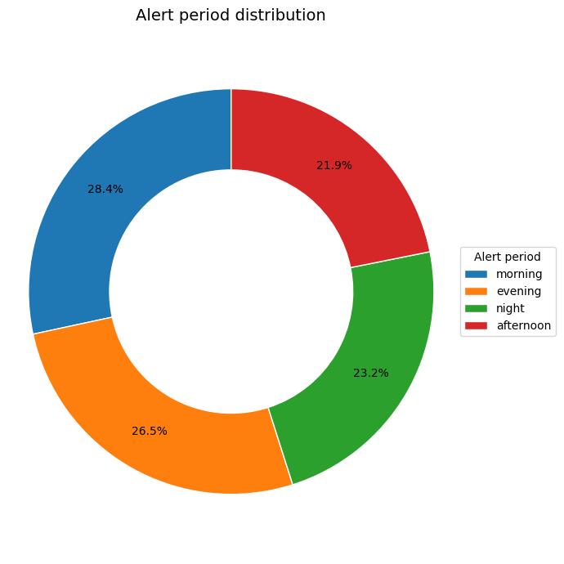

Slide 21
period region count
3 afternoon North 10396
0 afternoon Center 4690
4 afternoon South 4468
1 afternoon Haifa 802
5 afternoon Tel Aviv 622
6 afternoon Yosh 542
2 afternoon Jerusalem 398
7 evening Center 9170
10 evening North 6305
11 evening South 5570
13 evening Yosh 2472
9 evening Jerusalem 1556
12 evening Tel Aviv 910
8 evening Haifa 636
17 morning North 11269
14 morning Center 7796
18 morning South 5308
20 morning Yosh 1332
15 morning Haifa 1090
16 morning Jerusalem 1004
19 morning Tel Aviv 660
21 night Center 8898
24 night North 6257
25 night South 3488
27 night Yosh 1730
26 night Tel Aviv 1094
23 night Jerusalem 982
22 night Haifa 859

Slide 22
city count share
0 Ashdod 277 13.51
1 Tel Aviv-Yafo 197 9.61
2 Herzliyya 146 7.12
3 Ashkelon 137 6.68
4 Rishon LeZiyyon 117 5.70
5 Ben Shemen 112 5.46
6 Nir Am 110 5.36
7 Ramat Gan 105 5.12
8 Ramla 100 4.88
9 Haifa 81 3.95
10 Rosh HaAyin 79 3.85
11 Ibim 77 3.75
12 Sderot 77 3.75
13 Shefayim 69 3.36
14 Beersheba 69 3.36
15 Kiryat Shmona 63 3.07
16 Yashresh 60 2.93
17 Tzafria 59 2.88
18 Lod 58 2.83
19 Be'er Ya'akov 58 2.83

Slide 23
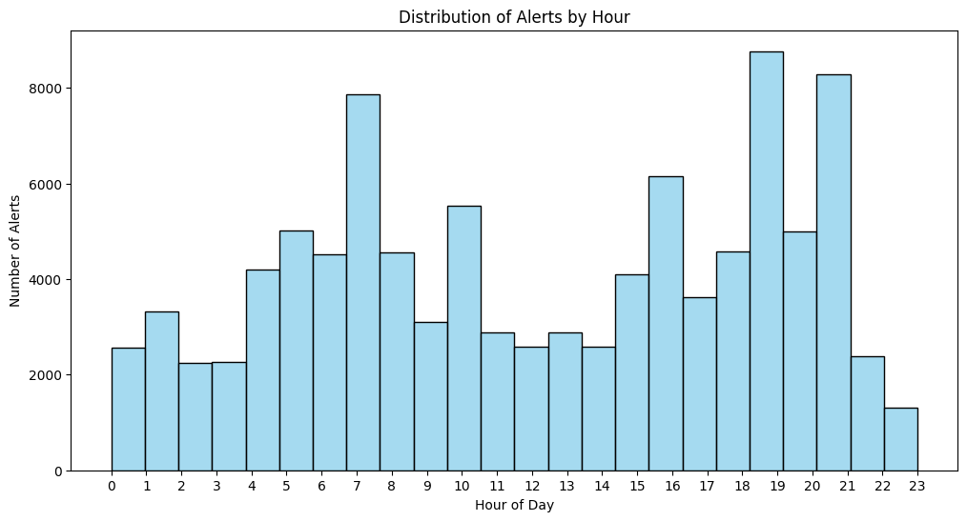

Slide 24
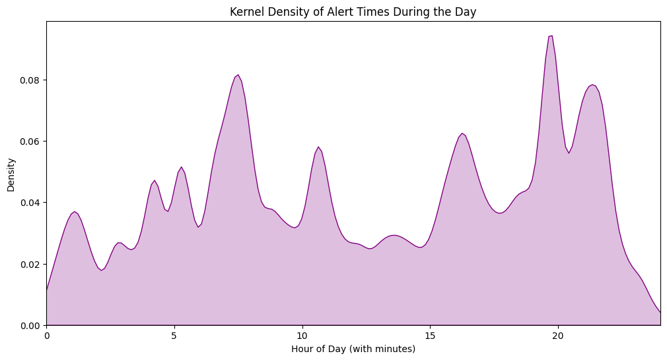

Slide 25
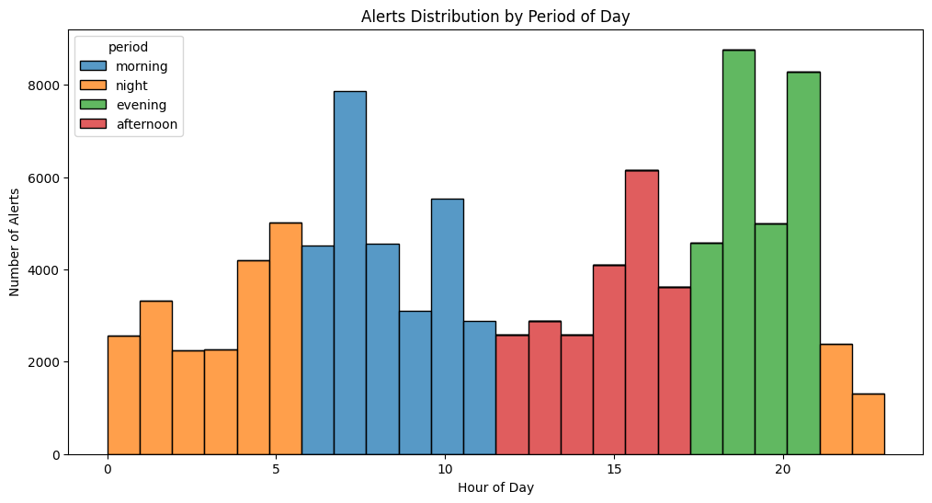

Slide 26
month_year count
0 2018-12-01 60
1 2019-01-01 32
2 2019-02-01 35
3 2019-03-01 327
4 2019-04-01 1
.. ... ...
70 2025-09-01 1987
71 2025-10-01 239
72 2025-11-01 8
73 2025-12-01 5
74 2026-01-01 1
[75 rows x 2 columns]

Slide 27
id alert_datetime alert_type alert_zone locality \
0 1 2018-12-26 08:05:08 Red Alert Dan Tel Aviv (South West)
1 2 2018-12-26 08:05:08 Red Alert Dan Tel Aviv (North)
2 3 2018-12-26 08:05:08 Red Alert Dan Tel Aviv (Central)
3 4 2018-12-26 08:05:08 Red Alert Dan Tel Aviv (South East)
4 5 2018-12-26 08:05:08 Red Alert Dan Azur
region raw_message_id city alert_date alert_time \
0 Tel Aviv 42 Tel Aviv-Yafo 2018-12-26 1900-01-01 08:05:08
1 Tel Aviv 42 Tel Aviv-Yafo 2018-12-26 1900-01-01 08:05:08
2 Tel Aviv 42 Tel Aviv-Yafo 2018-12-26 1900-01-01 08:05:08
3 Tel Aviv 42 Tel Aviv-Yafo 2018-12-26 1900-01-01 08:05:08
4 Tel Aviv 42 Azur 2018-12-26 1900-01-01 08:05:08
month_year period
0 2018-12 morning
1 2018-12 morning
2 2018-12 morning
3 2018-12 morning
4 2018-12 morning

Slide 28
id alert_datetime alert_type alert_zone locality \
0 1 2018-12-26 08:05:08 Red Alert Dan Tel Aviv (South West)
1 2 2018-12-26 08:05:08 Red Alert Dan Tel Aviv (North)
2 3 2018-12-26 08:05:08 Red Alert Dan Tel Aviv (Central)
3 4 2018-12-26 08:05:08 Red Alert Dan Tel Aviv (South East)
4 5 2018-12-26 08:05:08 Red Alert Dan Azur
region raw_message_id city alert_date alert_time \
0 Tel Aviv 42 Tel Aviv-Yafo 2018-12-26 1900-01-01 08:05:08
1 Tel Aviv 42 Tel Aviv-Yafo 2018-12-26 1900-01-01 08:05:08
2 Tel Aviv 42 Tel Aviv-Yafo 2018-12-26 1900-01-01 08:05:08
3 Tel Aviv 42 Tel Aviv-Yafo 2018-12-26 1900-01-01 08:05:08
4 Tel Aviv 42 Azur 2018-12-26 1900-01-01 08:05:08
month_year period year_clean minute_bucket
0 2018-12 morning 2018 00-minute
1 2018-12 morning 2018 00-minute
2 2018-12 morning 2018 00-minute
3 2018-12 morning 2018 00-minute
4 2018-12 morning 2018 00-minute

Slide 29
region minute_bucket count share
0 Center 00-minute 4622 0.15
1 Center 30-minute 4463 0.15
2 Center other 21469 0.70
3 Haifa 00-minute 525 0.16
4 Haifa 30-minute 571 0.17
5 Haifa other 2291 0.68
6 Jerusalem 00-minute 591 0.15
7 Jerusalem 30-minute 799 0.20
8 Jerusalem other 2550 0.65
9 North 00-minute 5981 0.17
10 North 30-minute 5442 0.16
11 North other 22804 0.67
12 South 00-minute 3862 0.21
13 South 30-minute 3035 0.16
14 South other 11937 0.63
15 Tel Aviv 00-minute 702 0.21
16 Tel Aviv 30-minute 496 0.15
17 Tel Aviv other 2088 0.64
18 Yosh 00-minute 400 0.07
19 Yosh 30-minute 871 0.14
20 Yosh other 4805 0.79

Slide 30
id alert_datetime alert_type alert_zone locality \
0 1 2018-12-26 08:05:08 Red Alert Dan Tel Aviv (South West)
1 2 2018-12-26 08:05:08 Red Alert Dan Tel Aviv (North)
2 3 2018-12-26 08:05:08 Red Alert Dan Tel Aviv (Central)
3 4 2018-12-26 08:05:08 Red Alert Dan Tel Aviv (South East)
4 5 2018-12-26 08:05:08 Red Alert Dan Azur
region raw_message_id city alert_date alert_time \
0 Tel Aviv 42 Tel Aviv-Yafo 2018-12-26 1900-01-01 08:05:08
1 Tel Aviv 42 Tel Aviv-Yafo 2018-12-26 1900-01-01 08:05:08
2 Tel Aviv 42 Tel Aviv-Yafo 2018-12-26 1900-01-01 08:05:08
3 Tel Aviv 42 Tel Aviv-Yafo 2018-12-26 1900-01-01 08:05:08
4 Tel Aviv 42 Azur 2018-12-26 1900-01-01 08:05:08
month_year period year_clean minute_bucket
0 2018-12 morning 2018 00-minute
1 2018-12 morning 2018 00-minute
2 2018-12 morning 2018 00-minute
3 2018-12 morning 2018 00-minute
4 2018-12 morning 2018 00-minute

Slide 31
year_clean minute_bucket count share
0 2018 00-minute 60 1.00
1 2019 00-minute 1047 0.22
2 2019 30-minute 428 0.09
3 2019 other 3242 0.69
4 2020 00-minute 56 0.17
5 2020 30-minute 44 0.14
6 2020 other 224 0.69
7 2021 00-minute 16 0.14
8 2021 30-minute 26 0.23
9 2021 other 71 0.63
10 2022 00-minute 335 0.32
11 2022 30-minute 101 0.10
12 2022 other 596 0.58
13 2023 00-minute 5081 0.34
14 2023 30-minute 3770 0.25
15 2023 other 5968 0.40
16 2024 00-minute 5756 0.18
17 2024 30-minute 5834 0.18
18 2024 other 20176 0.64
19 2025 00-minute 4331 0.09
20 2025 30-minute 5474 0.12
21 2025 other 37667 0.79
22 2026 00-minute 1 1.00

Slide 32
minute_bucket 00-minute 30-minute other
region
Center 0.15 0.15 0.70
Haifa 0.16 0.17 0.68
Jerusalem 0.15 0.20 0.65
North 0.17 0.16 0.67
South 0.21 0.16 0.63
Tel Aviv 0.21 0.15 0.64
Yosh 0.07 0.14 0.79

Slide 33
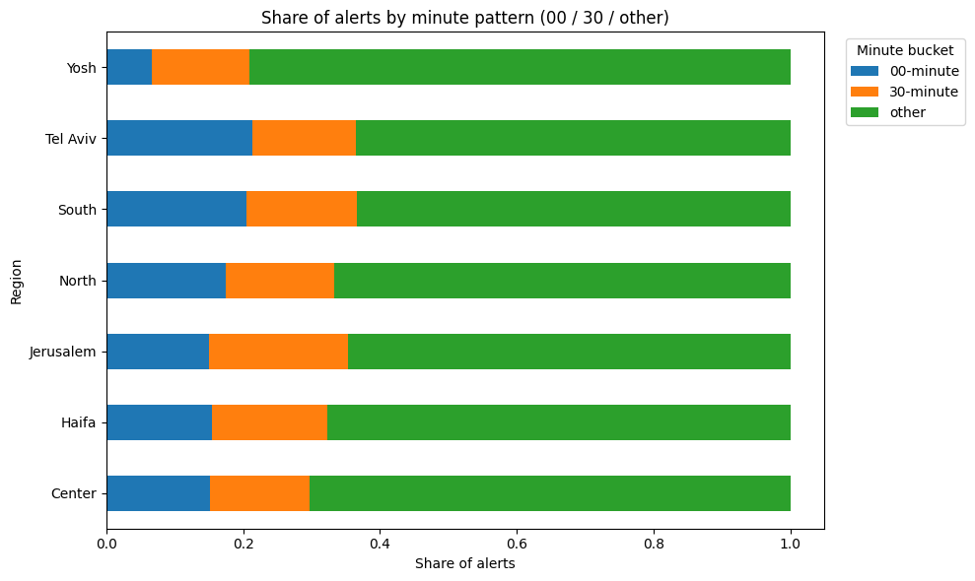

Slide 34
region minute_bucket count share n ci_low ci_high
0 Center 00-minute 4622 0.15 30554 0.15 0.16
1 Center 30-minute 4463 0.15 30554 0.14 0.15
2 Center other 21469 0.70 30554 0.70 0.71
3 Haifa 00-minute 525 0.16 3387 0.14 0.17
4 Haifa 30-minute 571 0.17 3387 0.16 0.18

Slide 35
Chi2: 53442.9478983889, p-value: 0.00000000000000000000000000000000000000000000000000
Chi2: 53442.9478983889, p-value: 0.00000e+00

Slide 36
region chi2 p_value p_value_sci
0 Center 18,755.34 0.00 0.00000e+00
1 Haifa 1,794.88 0.00 0.00000e+00
2 Jerusalem 1,763.18 0.00 0.00000e+00
3 North 17,084.26 0.00 0.00000e+00
4 South 7,706.02 0.00 0.00000e+00
6 Yosh 5,777.19 0.00 0.00000e+00
5 Tel Aviv 1,368.81 0.00 5.85582e-298

Slide 37
region alert_zone count
0 Center Ashdod 154
1 Center Beit Shemesh 5
2 Center Center Galilee 333
3 Center Center Negev 27
4 Center Confrontation Line 215

Slide 38
Exported all rows to 'by_region_zone_export.csv'.

Slide 39
month_year city count
0 2018-12 Bnei Brak 1
1 2018-12 Tel Aviv-Yafo 4
2 2019-02 Jerusalem 1
3 2019-03 Bnei Brak 2
4 2019-03 Tel Aviv-Yafo 6
.. ... ... ...
89 2025-09 Ashdod 9
90 2025-09 Bnei Brak 4
91 2025-09 Jerusalem 22
92 2025-09 Tel Aviv-Yafo 19
93 2025-10 Ashdod 20
[94 rows x 3 columns]

Slide 40
